Slide 1







PARAJUMBLES

Slide 2

INTRODUCTION
Para-jumbles are a very important topic of verbal section. It includes jumble sentences that form a meaningful paragraph which when unjumbled.
There is no set strategy to solve para-jumbles, but with deeper understanding and some practice, you can score well in this section.

Slide 3

TYPES OF PARA-JUMBLES
FIXED
MOVEABLE
Either one or both opening and closing lines given
All the lines are jumbled- need to identify theme and opening line

Slide 4
LET’S UNDERSTAND FIXED
1. When they gathered together, the Buddha was completely silent & some speculated that perhaps the Buddha was tired or ill.
2. It is said that Gautam Buddha gathered his disciples one day for a Dharma talk.
3. One of the Buddha's disciples, Maha kasyapa, silently gazed at the flower & broke into a broad smile.
4. The origin of Zen Buddhism is ascribed to the Flower Sermon, the earliest source which comes from the 14th century.
5. The Buddha silently held up & twirled a flower and twinkled his eyes, several of his disciples tried to interpret what this meant though none of them was correct.
A. EBDAC
B. DBAEC
C. BCDEA
D. CADBE

Slide 5
LET’S UNDERSTAND FIXED
1. When they gathered together, the Buddha was completely silent & some speculated that perhaps the Buddha was tired or ill.
2. It is said that Gautam Buddha gathered his disciples one day for a Dharma talk.
3. One of the Buddha's disciples, Maha kasyapa, silently gazed at the flower & broke into a broad smile.
4. The origin of Zen Buddhism is ascribed to the Flower Sermon, the earliest source which comes from the 14th century.
5. The Buddha silently held up & twirled a flower and twinkled his eyes, several of his disciples tried to interpret what this meant though none of them was correct.
A. EBDAC
B. DBAEC
C. BCDEA
D. CADBE
ANSWER: B
Here S2 is fixed and we need to rearrange the other options to make a meaningful paragraph

Slide 6


FIND THE PURPOSE OF THE SENTENCE
The primary goal of para jumble is to form a coherent paragraph that gives a message or at least makes sense. It is essential to find the purpose of these sentences. What is the author trying to achieve with these sentences? What does she want to explain? Try to find the purpose first, and this will eventually help you with the formation of the paragraph.

Slide 7
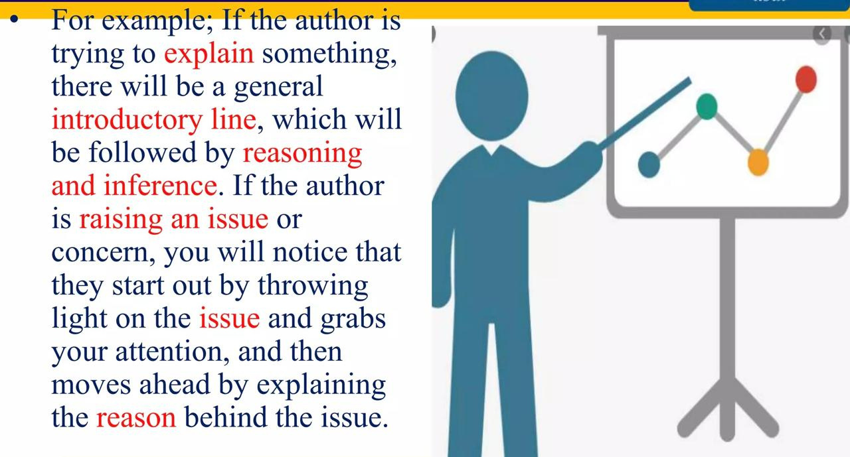

Slide 8
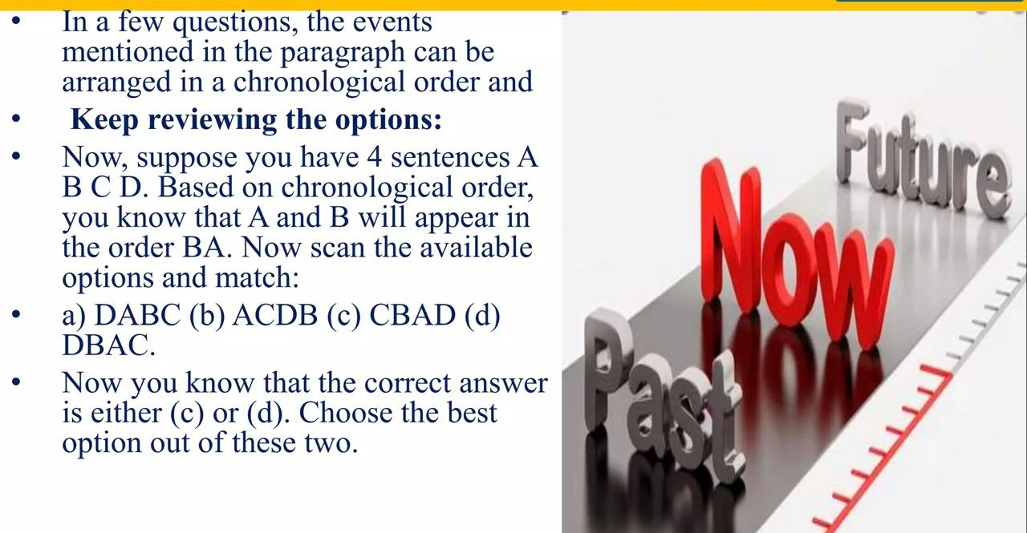
KEEP A CHECK ON CHRONOLOGY OF EVENTS

Slide 9
LET’S REARRANGE
Alexander Bain, Scottish clockmaker, patented the electric clock.
The next development in accuracy occurred after 1656 with the invention of the pendulum clock.
Clocks have played an important role in man's history.
Spring-driven clocks appeared during the 15th century, although they are often erroneously credited to Nuremberg watchmaker Peter Henlen around 1511

Slide 10
EXPLANATION
Then two astronomers—the German, Johannes Kepler, and the Italian, Galileo Galilei—started publicly to support the Copernican theory, despite the fact that the orbits it predicted did not quite match the ones observed.
His idea was that the sun was stationary at the centre and that the earth and the planets move in circular orbits around the sun.
A simple model was proposed in 1514 by a Polish priest, Nicholas Copernicus.
Nearly a century passed before this idea was taken seriously.
a. CDBA
b. CBDA
c. BCAD
d. CADB

Slide 11
CBDA

Slide 12
APPROACHES FOR PARAJUMBLES
1. NOUN-PRONOUN RELATIONSHIP APPROACH
In noun/pronoun relationships, we know that the noun will come first and will be referred to later using suitable pronouns. Study the following example:
A. People can get infected by handling reptiles and then touching their mouths or an open cut.
B. At first they look the perfect pets: exotic, quiet and tidy.
C. A study estimates that in 1995, there were as many as 6,700 reptile-caused salmonella infection.
D. But lizards and other pets can harbour a salmonella bacterium that makes people sick.
(a) BCAD
(b) BCDA
(c) ACDB
(d) BDCA

Slide 13
ANSWER: (d) BDCA
Read sentences C and D carefully. Sentence D contains the noun phrase “a salmonella bacterium” and Sentence C contains the noun phrase “salmonella infections”. What
is the relationship between the two? Since the phrase “a salmonella bacterium” introduces the bacterium, it should logically precede the phrase “salmonella infections”. Therefore, the sentence that contains the phrase “a salmonella bacterium” should come before the sentence that contains the phrase “salmonella infections”. So, Sentence D should precede Sentence C! Once you have a link between two sentences, look at the answer choices to see if you are on the right track. If you are, then you have the right answer : (d) BDCA

Slide 14
2. ACRONYM APPROACH: Full Form vs. Short Form
In Parajumble we encounter full and short names or sometimes acronyms of some term or institution.
Example: World Trade Organisation – WTO, Dr. Manmohan Singh – Dr. Singh, Karl Marx – Marx, President George W. Bush – President Bush or The President.
The rule is that if both full form as well as short form is present in different sentences, then the
sentence containing full form will come before the sentence containing short form.
A. If you are used to having your stimulation come in from outside, your mind never develops its own habits of thinking and reflecting.
B. Marx thought that religion was the opiate, because it soothed people’s pain and suffering and prevented them from rising in rebellion.
C. If Karl Marx was alive today, he would say that television is the opiate of the people.
D. Television and similar entertainments are even more of an opiate because of their addictive tendencies.
BACD
(b) ADBC
(c) BCDA
(d) CBDA

Slide 15
Solution
Sentence B has Marx (short form) and sentence C has Karl Marx (full form). So C will come before B.
Now look at the options. In option (a), (b) and (c), B is placed before C— hence, rejected. Option (d) is the right answer.

Slide 16
3. TIME SEQUENCE APPROACH (TSA)
This provides a way for us to identify the correct sequence of the sentences by arranging the sentences using their proper time sequence. Some words through which a time sequence may be indicated are – Before, after, later, when, etc.
Example
A. Then two astronomers—the German, Johannes Kepler, and the Italian, Galileo Galilei—started publicly to support the Copernican theory, despite the fact that the orbits it predicted did not quite match the ones observed.
B. His idea was that the sun was stationary at the centre and that the earth and the planets move in circular orbits around the sun.
C. A simple model was proposed in 1514 by a Polish priest, Nicholas Copernicus.
D. Nearly a century passed before this idea was taken seriously.
(a) CADB (b) BCAD
(c) CBDA (d) CDBA

Slide 17
Solution
In the above example you will observe that the flow of logic is in the form of a time sequence which flows from the oldest time period to a more contemporary time
period. Therefore, Sentence C will be the first sentence. Sentence B expands upon the “simple model” proposed, hence, it will be the sentence following
C. The next sentence in the order of chronology is C—nearly a century passed, while the last sentence will be A which completes the sequence from older time to contemporary time thus giving us the answer as CBDA.

Slide 18
4. STRUCTURE APPROACH
English provides certain sequencing words – firstly, secondly, then, however, consequently, on the other hand, etc. – which writers use to join sentences or ideas together and to provide a smooth flow from one idea to the next. It is essential to learn how to spot these words and learn how to use them correctly. Parajumble sentences often contain several signal words, combining them in complex ways.
CAUSE AND EFFECT SIGNALS SUPPORT SIGNAL WORDS CONSTRAST SIGNALS
Accordingly furthermore nevertheless
in order to additionally nonetheless
because also on the contrary
So….that and not with-standing
Consequently indeed and
Therefore besides even though
Given as well instead of
Thus too despite
Hence likewise in spite of
When….then moreover while
If….then in contrast
although
however

Slide 19
Example:
A. When conclusions are carefully excluded, however, and observed facts are given instead, there is never any trouble about the length of the papers.
B. The reason for this is that those early paragraphs contain judgments that there is little left to be said.
C. A judgment (“He is a boy”, “She is an awful bore”) is a conclusion, summing up a large number of previously observed facts.
D. In fact, they tend to become too long, since inexperienced writers, when told to give facts, often give more than are necessary, because they lack discrimination between the important and the trivial.
E. It is a common observation among teachers that students almost always have difficulty in writing themes of the required length because their ideas give out after a paragraph or two.
(a) ECDAB
(b) CEBAD
(c) EACBD
(d) EBCAD

Slide 20
Solution:
Sentence E states the situation in general and gives us information about why students have problems “in writing themes of the required length”. Sentence B goes on to tell us “the reason for this”, so the two sentences must be related. Similarly, Sentence C is related to Sentence B because both sentences contain the word “judgment”, with Sentence C explaining what the word means. Once a link of this nature is established, go to the answer choices to see if you are on the right track. D any of the answer choices offer our line of reasoning?
Answer (d) does.
In the above jumble, the word “however” in Sentence A suggests a contrast to something mentioned previously. In situations of this kind, it is always a good idea to separate the argument clearly. Sentences A and D, therefore, should come together. Now you try.

Slide 21
5. LINKING THE SENTENCE
Example
A. In America, highly educated women, who are in stronger position in the labour market than less qualified ones, have higher rates of marriage than other groups.
[A is the opening statement. You are required to re-arrange the following four statements].
B. Some work supports the Becker thesis, and some appears to contradict it.
C. And, as with crime, it is equally inconclusive.
D. But regardless of the conclusion of any particular piece of work, it is hard to establish convincing connections between family changes and economic factors using conventional approaches.
E. Indeed, just as with crime, an enormous academic literature exists on the validity of the pure economic approach to the evolution of family structures.

Slide 22
Solution:
Can B be the opening statement – Very Unlikely. There is no mention of “Becker thesis” in the opening statement.
Can C be the opening statement – Two words in the statement – “Crime” and “Inconclusive” make this as the statement after A very unlikely.
Can D be the opening statement – Though it furthers the idea presented in statement A, usage of word like “But” make it unlikely to be the statement coming just after statement A. Besides, statement A does not talk about any piece of work. In fact, statement A is just an
opinion.
Can E be the opening statement – Yes. E is the statement after A – both through elimination of other statements and selection.
Next statement should be C, as it again talks about ‘Crime’ and how inconclusive it is (despite “an enormous academics literature exists” as given
Next statement:
D should be the last statement as it concludes the whole theme that “it is hard to establish”. Now
the whole point is – how do we place statement B and Becker thesis, which finds no mention in the whole passage. Only reasoning that can be given here is – Probably this passage has been taken from a book or project report which has something to do with Becker Thesis, and this passage is just a small part of it.
Now let us look at the options and try to eliminate the options with the help of the conclusions that we have derived so far:
A. BCDE – Ruled out as E is the 1st statement.
B. DBEC – Ruled out as E is the 1st statement.
C. BDCE – Ruled out as E is the 1st statement.
D. ECBD – Answer.
E. EBCD – Ruled out as EC is the link. Hence, option (d) is the answer.

Slide 23
DIRECTIONS for the question: The question consists of five statements labelled A, B, C, D and E which when logically ordered form a coherent passage. Choose the option that represents the most logical order..
A. No longer are they so blinded as in the past by the glare and tinsel of the State idea, and of the 'blessings' of 'rugged individualism."
B. The spirit of government has always worked against the social application of this vital lesson, except where it served the State and aided its own particular interests.
C. The individual and ever larger groups of individuals are beginning to see beneath the surface of the established order of things.
D. It is this anti-progressive and anti-social spirit of the State and of the privileged castes which has been responsible for the bitter struggle between man and man.
E. The long process of history has taught man that division and strife mean death, and that unity and cooperation advance his cause, multiply his strength and further his welfare.
A) ECABD B) DCBEA
C) CABDE D) EBDCA

Slide 24
Explanation:- D) EBDCA
This vital lesson in B is talked about in E. Hence EB will be a pair.
Statement A continues with the idea mentioned in C, hence CA is another pair. The spirit talked about in D is continuation of B.
Hence option D shows the correct arrangement.

Slide 25
DIRECTIONS: The question consists of five statements labelled A, B, C, D and E which when logically ordered form a coherent passage. Choose the option that represents the most logical order.
A. In simpler terms, it is the Indian version of the Razzies.
B. The 3rd Golden Gela Awards will be hosted by Cyrus Broacha this year.
C. It was created in order to ridicule the bad performances and as a revenge for wasting our precious time and money on such idiotic films.
D. The Golden Gela is held each year where awards are given for the year's worst in Bollywood.
E. It was created by Random magazine, India's longest running humor magazine in the year 2009.
A) DAECB B) BACDE
C) ACEDB D) CEADB

Slide 26
Explanation:- DAECB
The paragraph talks about Golden Kela Awards.
D introduces the Golden Kela awards,so it is the opening sentence (INTRO)
A explains what the awards are. Hence A follows D.( keywords: in simpler terms) (EXPLANATION OF TOPIC)
E is dependent on A as it continues the intro of kela awards by telling about its creation. ( HISTORY)
C statement tells the purpose of these awards.(PURPOSE)
B statement talks about the present that is why it is the closing sentence.

Slide 27
DIRECTIONS: The question consists of five statements labelled A, B, C, D and E which when logically ordered form a coherent passage. Choose the option that represents the most logical order.
A. Despite the strong performance of the economy in 2010-11, the outlook for 2011-12 is clouded by stubborn and persistently high inflation, and rising external risks.
B. The three key macroeconomic concerns before the Union Budget 2011-12 were high inflation, high current account deficit(CAD), and fiscal consolidation.
C. Additionally, there was an expectation that the government would restart the reform process.
D. While the Budget sets a lower nominal gross domestic product (GDP) growth target of 14%, we believe that the real GDP growth target of 9% factored in the Budget is on the optimistic side.
E. The Budget has made an attempt to address all these issues, albeit through small steps.
A) BCEAD B) CBAED
C) DACEB D) ADCEB

Slide 28
Explanation:- A) BCEAD
B is the opening sentence , as it is independent and introduces three main problems.
The word Additionally means that there must be something before sentence C. These issues in
E are the issues mentioned in B and C. B will be followed by C, which will be followed by E. Hence, BCE is the mandatory pair.

Slide 29
DIRECTIONS: The question consists of five statements labelled A, B, C, D and E which when logically ordered form a coherent passage. Choose the option that represents the most logical order.
A. In a bid to placate the associate members, the ICC has decided to increase the number of participating teams to 16 in theTwenty20 World Cup, as the game's governing body feels these countries will have a greater chance of competing on an equal footing in cricket's shortest format.
B. It is convenient just now to forget that in the last edition of the tournament, considerable criticism was heaped on the governing body for the inordinate length of the tournament, thanks in large part to the presence of the associates.
C. To be fair to the ICC, criticism of the move to restrict the number of teams in the next edition of the Cup is a case of damned if you do, damned if you don't.
D. The ICC's decision to restrict the number of teams in the 2015 World Cup has evoked mixed responses, with opinion divided among players of the full member teams.
E. Not surprisingly, the associate members aren't too thrilled about the idea of being kept out of cricket's showpiece event.
A) ECDAB B) BAECD
C) DACEB D) DEACB

Slide 30
Explanation:- D) DEACB
The paragraph talks about the ICC’s decision to restrict the number of teams and the response that it evoked. The decision is introduced in sentence D.
On one hand the ICC was criticized because of the inordinate length of the tournament and now it is criticized when it wants to reduce the number of teams. Hence, DEAC forms a logical sequence.
Sentence C will be followed by B as B shows the other side of the coin.

Slide 31
DIRECTIONS for the question: Choose the most logical order of sentences from among the given choices to construct a coherentparagraph.
(a) The impression that corruption is a universal phenomenon persists and the people do not co-operate in checking this evil.
(b) So there is hardly anything that the government can do about it now.
(c) It is regrettable that there is a widespread corruption in the country at all levels.
(d) Recently several offenders were brought to book, but they were not given deterrent punishment.
A) CDAB B) ADBC
C) ADCB D) CBAD

Slide 32
Explanation:- A) CDAB
The correct sequence is cdab.
Statement (c) should be followed by statement (d) because the former talks about the existence of corruption at all levels and thelatter carries forward the idea by stating that such corrupt people have also been brought to the book.;
Statement (d) should be followed by statement (a) because (d) talks about offenders not being given deterrent punishment and (a)gives its reason.
Statement (a) should be followed by statement (b) because (a) talks about people not checking corruption and (b) gives aconsequence of it.
Hence, option (A) is the correct answer.

Slide 33
DIRECTIONS for the question: Choose the most logical order of sentences from among the given choices to construct a coherent paragraph.
P: You couldn't have asked for a nicer, more respectable-looking fellow than Jack, the day he arrived in town for grandpa's funeral.
Q: He'd just arrived that morning, got the word that the old Judge was gone, he said.
R: He rode into the yard on his motorbike - the one he'd sold last summer, which wasn't a patch on the big redone he'd bought later.
S: He was glad he was in time for the services. He sat with Paresh all through the funeral; he even cried - or if it wasn't crying, it was a darned good show.
The proper sequence should be
A) QRPS B) QRSP
C) SPQR D) PRQS

Slide 34
Explanation:- D) PRQS
PRQS,
Name of the person is introduced in P,
Then Noun –pronoun pair, so R,
QS makes a mandatory pair, ‘judge was gone, Funeral’

Slide 35
DIRECTIONS for the question: The question consists of five statements labelled A, B, C, D and E which when logically ordered form a coherent passage. Choose the option that represents the most logical order..
A. If human rights are used as a cloak by governments to put on or cast away according to political expediency, can the international community of states be trusted to bring about that vision?
B. Bypassed in the Iraq war and marginalized in its aftermath, discredited by its perceived vulnerability to pressure from powerful states, the UN seemed virtually paralyzed in its efforts to hold states to account for their adherence to international law and their performance on human rights.
C. As one of the most prominent international human rights defenders lay dying in the rubble, the world had good cause to ponder how the legitimacy and credibility of the UN could have been eroded to such a fatal degree.
D. It was easy at that moment to wonder whether the events of 2003 had also dealt a mortal blow to the vision of global justice and universal human rights that first inspired the creation of global institutions such as the UN.
E. And what can the international community of citizens do to rescue human rights from the rubble?
A) BCAED B) CBDEA
C) BECDA D) CBDAE

Slide 36
Explanation:- D) CBDAE
The eroding of the legitimacy and credibility of the UN is reflected in B, which talks about the UN being bypassed in the Iraq warand the perceived vulnerability to pressure from powerful states.
D takes the idea further. Hence B-D is a pair.
A-E is a pair as E folows A.
All this arrangement is found in
option D

Slide 37
DIRECTIONS for the question: The question consists of five statements labelled A, B, C, D and E which when logically ordered form a coherent passage. Choose the option that represents the most logical order..
A. No longer are they so blinded as in the past by the glare and tinsel of the State idea, and of the 'blessings' of 'rugged individualism."
B. The spirit of government has always worked against the social application of this vital lesson, except where it served the State and aided its own particular interests.
C. The individual and ever larger groups of individuals are beginning to see beneath the surface of the established order of things.
D. It is this anti-progressive and anti-social spirit of the State and of the privileged castes which has been responsible for the bitter struggle between man and man.
E. The long process of history has taught man that division and strife mean death, and that unity and cooperation advance his cause, multiply his strength and further his welfare.
A) ECABD B) DCBEA
C) CABDE D) EBDCA

Slide 38
Explanation:- D) EBDCA
This vital lesson in B is talked about in E. Hence EB will be a pair.
Statement A continues with the idea mentioned in C, hence CA is another pair. The spirit talked about in D is continuation of B.
Hence option D shows the correct arrangement.

Slide 39
Directions for Questions: Sentences given in each question, when properly sequenced, form a coherent paragraph. The first and last sentences are 1 and 6, and the four in between are labelled A, B, C and D. Choose the most logical order of these four sentences from among the four given choices to construct a coherent paragraph from sentences 1 to 6.
1. Security inks exploit the same principle that causes the vivid and constantly changing colours of a film of oil on water.
A. When two rays of light meet each other after being reflected from these different surfaces, they have each travelled slightly different distances.
B. The key is that the light is bouncing off two surfaces, that of the oil and that of the water layer below it.
C. The distance the two rays travel determines which wavelengths, and hence colours, interfere constructively and look bright.
D. Because light is an electromagnetic wave, the peaks and troughs of each ray then interfere either constructively, to appear bright, or destructively, to appear dim. 6. Since the distance the rays travel changes with the angle as you look at the surface, different colours look bright from different viewing angles.
1. ABCD 2. BADC 3. BDAC 4. DCAB

Slide 40
2. BADC

Slide 41
The five sentences labelled (1, 2, 3, 4, 5) given in this question, when properly sequenced, form a coherent paragraph. Each sentence is labelled with a number. Decide on the proper order for the sentences and key in this sequence of five numbers as your answer.
Scientists have for the first time managed to edit genes in. a human embryo to repair a genetic mutation, fueling hopes that such procedures may one day be available outside laboratory conditions.
The cardiac disease causes sudden death in otherwise healthy young athletes and affects about one in 500 people overall.
Correcting the mutation in the gene would not only ensure that the child is healthy but also prevents transmission of the mutation to future generations.
It is caused by a mutation in a particular gene and a child will suffer from the condition even if it inherits only one copy of the mutated gene.
In results announced in Nature this week, scientists fixed a mutation that thickens the heart muscle, a condition called hypertrophic cardiomyopathy.

Slide 42
Answer: 15243

Slide 43
THANK YOU VERY MUCH!
WWW.REALLYGREATSITE.COM

